Slide 1
Arduino Car Functionalities
Robotics 360

Slide 2
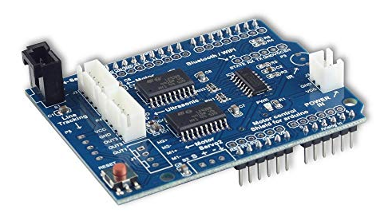
Objective
Build a mini car (like in Class 1) where the car runs till it senses an obstacle, and then moves accordingly
It is a special electronic circuit board , that can fit on top of a Arduino UNO Board
It has pre-designed pin to connect with
Ultrasonic Sensor
Servo Motor
DC Motor
Arduino Shield

Slide 3
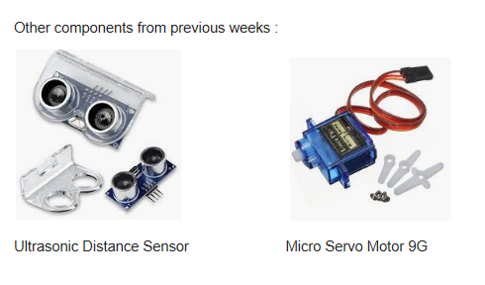
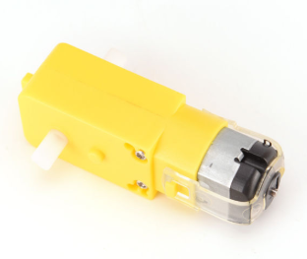
Components needed
DC Motors (20 to 200 RPM)

Slide 4
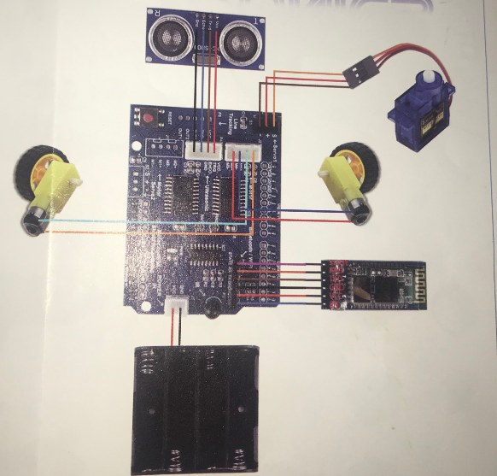
Arduino Car - Design
Follow the demonstration!

Slide 5
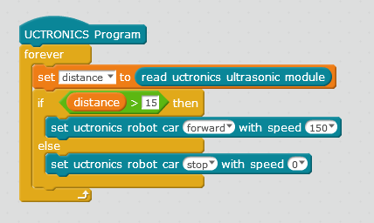
Arduino Car - Programming
Create an extra variable: distance (this is a replacement of the sensor’s distance variable)
This program keeps the car running till the sensor senses something within 15 cm, then it stops.

